Slide 1
Digital Portfolio
STUDENT NAME: J.JAYAPRATHI
REGISTER NO AND NMID: 24134061802522020 AND 19B717568BFE072AEB44B814B6E3A641
DEPARTMENT: II BS.C COMPUTER SCIENCE
COLLEGE: COLLEGE/ UNIVERSITY: DHARMAPURAM ADHINAM ARTS COLLEGE/ANNAMALAI UNIVERSITY

Slide 2
PROJECT TITLE
Digital Portfolio

Slide 3


AGENDA
Problem Statement
Project Overview
End Users
Tools and Technologies
Portfolio design and Layout
Features and Functionality
Results and Screenshots
Conclusion
Github Link
3/21/2024 Annual Review

Slide 4

PROBLEM STATEMENT
In the digital era, individuals often face challenges in showcasing their skills, achievements, and projects in a structured and professional manner. Traditional resumes and CVs fail to highlight practical work effectively. A Digital Portfolio addresses this gap by providing an online space where students and professionals can display their talents and accomplishments interactively

Slide 5

PROJECT OVERVIEW
This project focuses on the development of a digital portfolio website. The portfolio enables users to showcase personal information, academic achievements, technical skills, projects, and extracurricular activities. It is designed with a user-friendly layout, responsive design, and visually appealing elements that make it suitable for career and academic purposes.

Slide 6

WHO ARE THE END USERS?
Students seeking internships or higher education opportunities. - Job seekers wanting to display their projects and skills. - Freelancers and professionals aiming to showcase their portfolios.

Slide 7

TOOLS AND TECHNIQUES
HTML, CSS, JavaScript – For front-end design and interactivity. - GitHub – For hosting and version control. - Responsive Design – For mobile and desktop compatibility

Slide 8
POTFOLIO DESIGN AND LAYOUT
The portfolio is structured into multiple sections including Home, About, Projects, Skills, and Contact. The design follows a clean, modern aesthetic with smooth navigation and responsive grids. Emphasis is placed on simplicity and readability, making it professional and user-friendly.
8

Slide 9
FEATURES AND FUNCTIONALITY
Personalized profile page with photo and introduction. - Dedicated section for academic and professional projects. - Interactive contact form for communication. - Responsive design ensuring compatibility across devices. - Integration with GitHub for live project showcases.

Slide 10
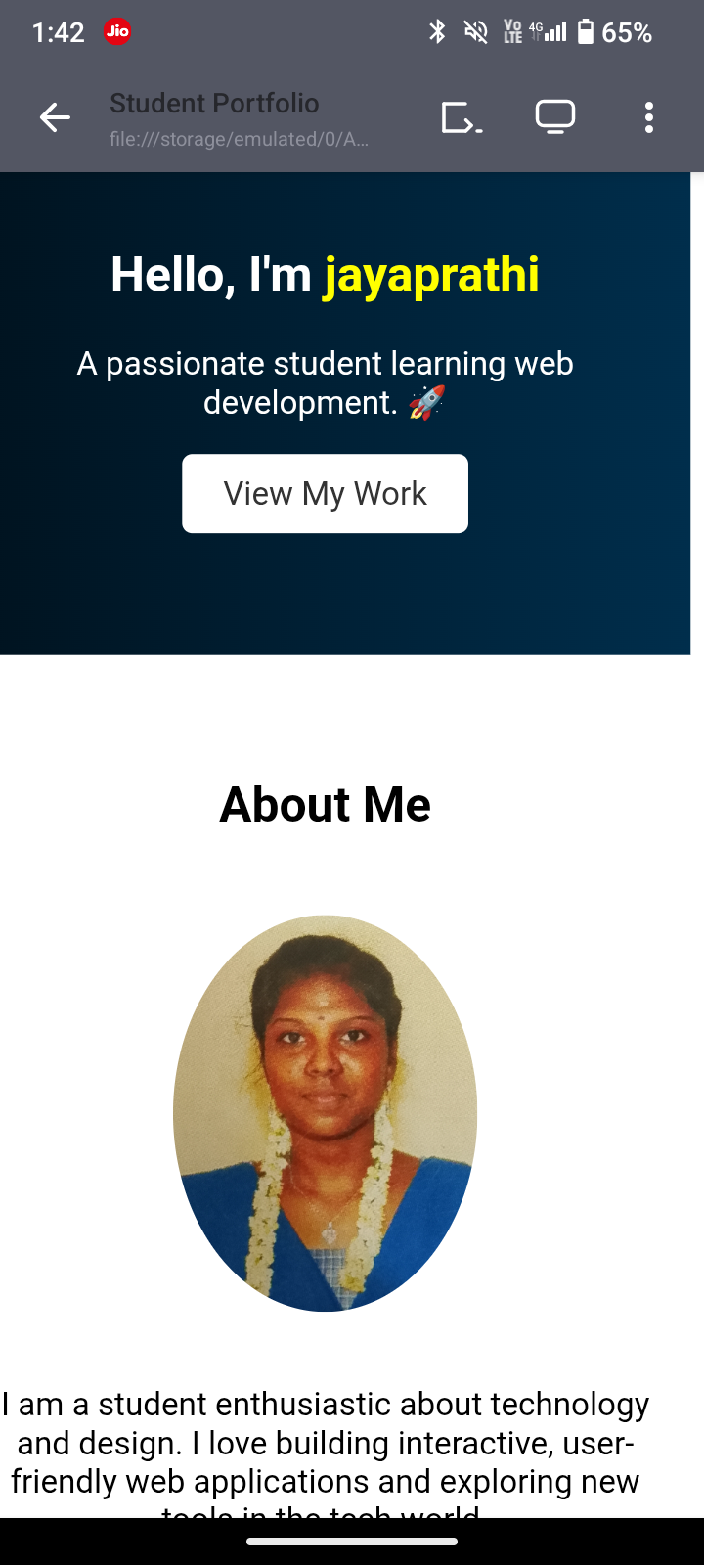

RESULTS AND SCREENSHOTS
3/21/2024 Annual Review
10

Slide 11
CONCLUSION
The Digital Portfolio project highlights the importance of having an online presence in today’s digital world. It provides students and professionals with a platform to present their skills and achievements beyond the traditional resume. In the future, additional features like blogs, video integration, and advanced analytics can be incorporated to further enhance its functionality
11

